Slide 1

Introduction to Django - models and Admin interface
Web 3

Slide 2
If you have a chance, let me know your impressions about this paper
Your feedback helps me to find out what aspects of the paper worked and what needs refinement
You can fill
Teaching evaluations
Course evaluations

Slide 3
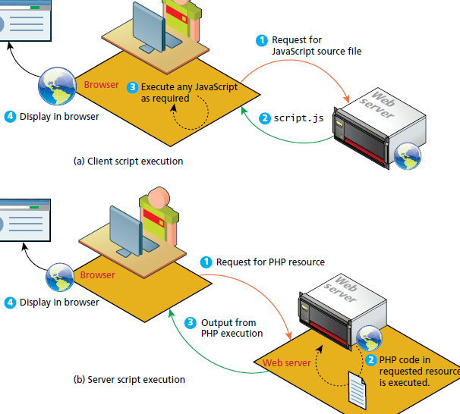
Comparing Client and Server Scripts
In a client-side script the code is executed on the client browser
In a server-side script, it is executed on the web server. Your software runs on a web server and uses the HTTP requestresponse loop for most interactions with the clients
The location of the script also impacts what resources it can access.
Server scripts cannot manipulate the HTML or DOM of a page in the client browser as is possible with client scripts.
A server script can access resources on the web server whereas the client cannot

Slide 4
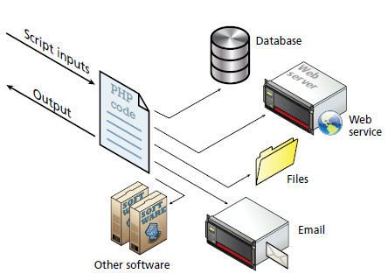
Server-side script resources
A server-side script can access any resources made available to it by the server
These resources can be categorized as
data storage
DBMS
web services
use the HTTP protocol to return XML, JSON or other data
software applications
authentication services
email

Slide 5
Comparing Server-Side Technologies
ASP (Active Server Pages): This was Microsoft’s first server-side technology (also called ASP Classic)
ASP.NET: This replaced Microsoft’s older ASP technology. ASP.NET is part of Microsoft’s .NET Framework and can use any .NET programming language (though C# is the most commonly used). ASP.NET uses an explicitly object-oriented approach. It is often used in larger corporate web application systems. It also uses special markup called web server controls that encapsulate common web functionality such as database-driven lists, form validation, and user registration wizards. A recent extension called ASP.NET MVC makes use of the Model-View-Controller design pattern. It is essentially limited to Windows servers.

Slide 6
Comparing Server-Side Technologies
JSP (Java Server Pages): uses Java as its programming language and uses an explicit object-oriented approach. It is used in large enterprise web systems and is integrated into the J2EE environment. Usage in the web as a whole is small, but it has a substantial market share in the intranet environment
PHP: a dynamically typed language that can be embedded directly within the HTML, though it now supports most common object oriented features, such as classes and inheritance.
Perl: Until the development and popularization of ASP, PHP, and JSP, Perl was the language typically used for early server-side web development. As a language, it excels in the manipulation of text. It was commonly used in conjunction with the Common Gateway Interface (CGI), an early standard API for communication between applications and web server software.

Slide 7
Comparing Server-Side Technologies
Ruby on Rails. Web development framework that uses the Ruby programming language. It emphasizes the use of common software development approaches, in particular the MVC design pattern. It integrates features such as templates and engines that aim to reduce the amount of development work required in the creation of a new site.
ColdFusion. ColdFusion is a tag-based, back-end web language that has been around since the mid-1990′s. CFML compares to the scripting components of ASP, JSP, and PHP in purpose and features, but its tag syntax more closely resembles HTML, while its script syntax resembles JavaScript.

Slide 8
Comparing Server-Side Technologies
Node.js. As you know, a recent server environment that uses JavaScript on the server side, thus allowing developers already familiar with JavaScript to use just a single language for both client-side and server-side development. node.js is also its own web server software, thus eliminating the need for Apache, IIS, or some other web server software.
Django. A high-level free and open source Python Web framework that encourages rapid development and clean, pragmatic design. It follows the model – view – controller (MVC) architectural pattern.

Slide 9
Comparing Server-Side Technologies
Microframeworks:
Express (which uses the JavaScript programming language).
Flask (minimalistic web framework that uses Python)
Sinatra (which uses the programming language Ruby).
Bottle (which uses Python).

Slide 10
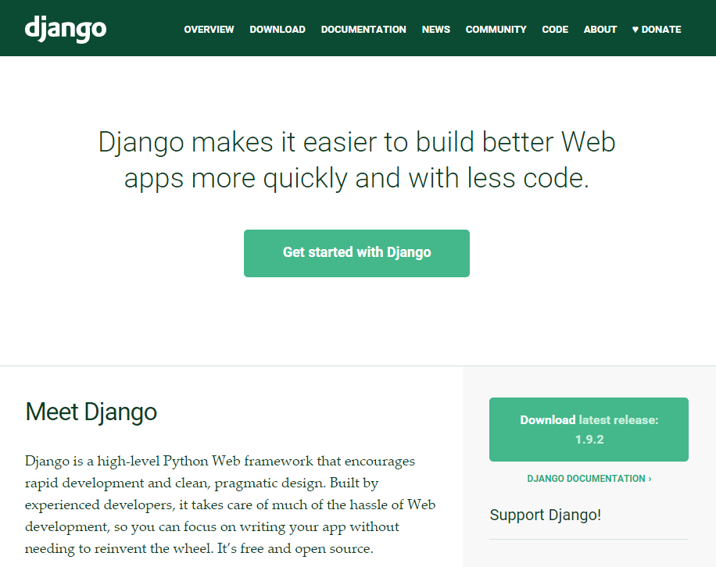
Django
https://www.djangoproject.com/

Slide 11
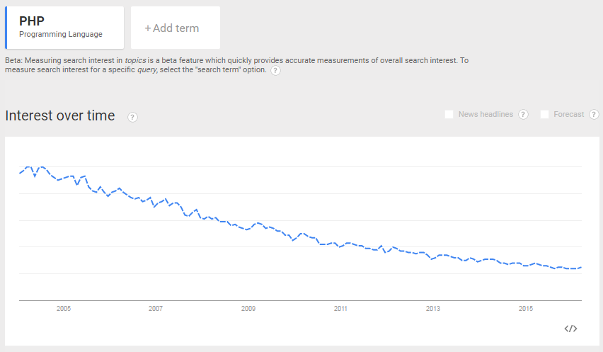
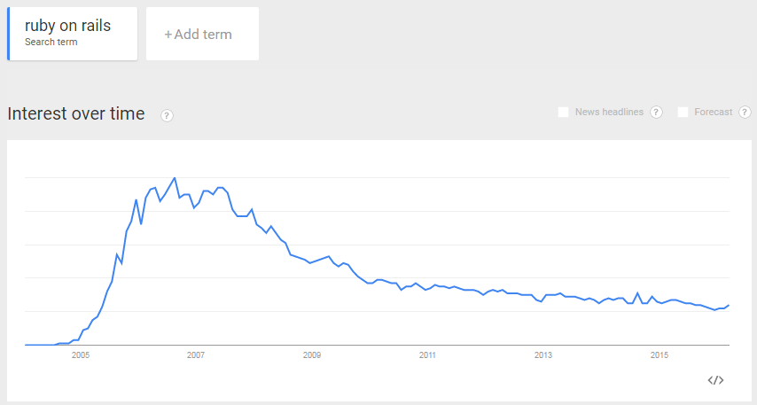
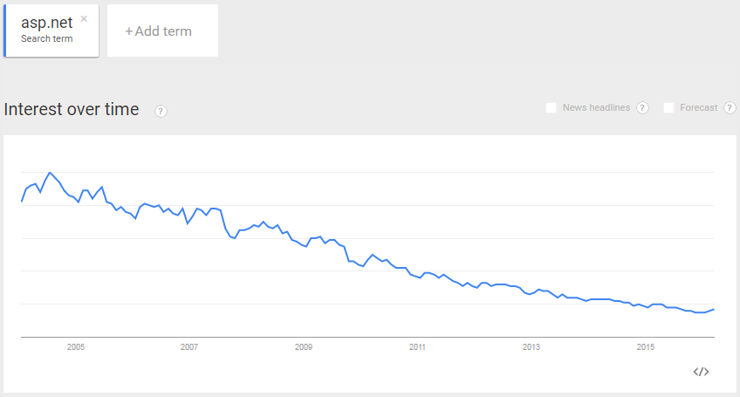
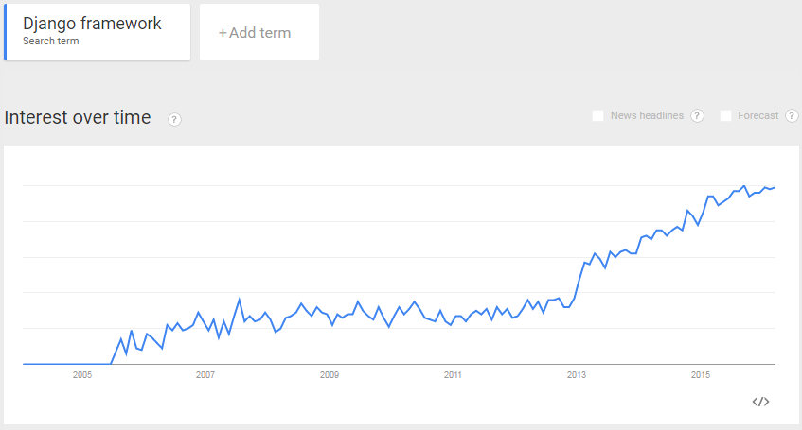
Why Django

Slide 12
Sites using Django
https://www.instagram.com/
https://www.washingtonpost.com/
https://www.nasa.gov/
http://www.nationalgeographic.com/
https://www.mozilla.org/en-US/
http://www.theonion.com/
https://www.pinterest.com/
https://prezi.com/
https://bitbucket.org/
https://www.chess.com/
https://www.redditgifts.com/
https://disqus.com/

Slide 13
What is Django?
A high-level Python Web framework that encourages rapid development and clean, pragmatic design
What is a web framework?
A web framework is a collection of tools used to build websites or web apps.
Django is not a programming language!
Python is the programming language used when working with Django
Python is used throughout, even for settings, files, and data models.
Django is also not a web server.
It comes with a built-in one as a convenience for development, but when used outside of development as a real website, Django works with web servers such as Apache or Nginx
Django's primary goal is to ease the creation of complex, database-driven websites
Django emphasizes reusability and "pluggability" of components, rapid development, and the principle of don't repeat yourself (DRY)
Django also provides an optional administrative create, read, update and delete interface that is generated dynamically through introspection and configured via admin models.

Slide 14
Django Features
An object-relational mapper (ORM) that mediates between data models (defined as Python classes) and a relational database ("Model");
HTML templating system that borrows the concept of inheritance from OO programming allows us to process HTTP request and have presentation logic and insertion of data into the HTML output
Django also comes with regular-expression-based URL routing (URL dispatcher), which helps determine what logic to follow depending on the URL of a web request
A lightweight and standalone web server for development and testing
A form serialization and validation system that can translate between HTML forms and values suitable for storage in the database
A caching framework that can use any of several cache methods
Support for middleware classes that can intervene at various stages of request processing and carry out custom functions
An internal dispatcher system that allows components of an application to communicate events to each other via pre-defined signals
An internationalization system, including translations of Django's own components into a variety of languages
Tools for Unit testing
A serialization system that can produce and read XML and/or JSON representations of Django model instances

Slide 15
Bundle applications
The main Django distribution bundles a number of applications in its "contrib" package, including:
an extensible authentication system
the dynamic administrative interface
tools for generating RSS and Atom syndication feeds
a sites framework that allows one Django installation to run multiple websites, each with their own content and applications
tools for generating Google Sitemaps
built-in mitigation for cross-site request forgery, cross-site scripting, SQL injection, password cracking and other typical web attacks, most of them turned on by default

Slide 16
Django Project Structure
The normal Django workflow, starts a project with the command:
django-admin startproject [projectname]
__init__ is generated so that python will consider the folder to be a python module.
The role of the manage.py file is to run commands for our project
Inside of the first Django folder are the files wsgi.py, settings.py and urls.py.
The wsgi.py file is used by a web server to run the Django project.
The settings.py file is used to configure our project
the urls.py file configures what code is run when a request comes in based on the url path
projectname\
manage.py
projectname\
settings.py
urls.py
wsgi.py
__init__.py

Slide 17
Django App Structure
A project is composed of one or more apps
You can create an app within a project with the command
python manage.py startapp blog
The models.py file defines the data layer of the application, such as the structure of the database tables and how they are queried
The admin.py file defines the administrative interface for viewing and updating data for that application
The views.py file defines the program logic for that app and each one takes an http web request and returns an http response
The tests.py file defines automated tests on the code within that application
the migrations folder contains files that automate how database tables are created or changed over time for that app. These files are often auto-generated but can be created by hand
projectname\
manage.py
projectname\ settings.py
urls.py
wsgi.py
__init__.py
blog\
migrations\
init__.py
__init__.py
admin.py
models.py
tests.py
views.py

Slide 18
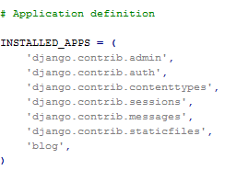
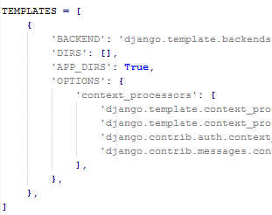

Django Settings.py
The INSTALLED_APPS
used for adding or removing apps from the project
The TEMPLATES
when we first add template files to our project.
STATICFILES_DIRS
when we add static assets such as CSS and JavaScript to our project
DEBUG
is best set to false when your web project is deployed
DATABASES
We're using the built in default database called SQLite, but if you want to use a production ready database such as PostgreSQL or MYSQL, you'll need to change the engine and name entries in the DATABASES setting

Slide 19
Django Models (models.py)
Typically, a Django app contains a models.py file
Create the data layer of an app
Define the structure of our data and how it will be stored in the database
Allows us to query data from the database
The models.py file contains any number of models.
A model is a class that inherits from django.db.models.Model.
Models use class attributes to define the fields for the given model.
As an analogy, we can conceptualize models as spreadsheets.
Each model is a table in a spreadsheet, while each field of the model is a column for that spreadsheet table.
Once our database is populated with data, we can think of each record in the database as a row in the spreadsheet.

Slide 20
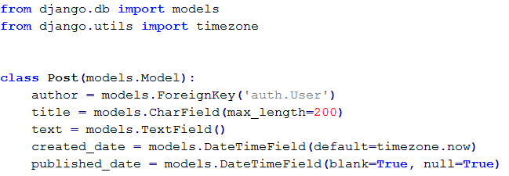
Django Models (models.py)

Slide 21
Field Types
IntegerField and DecimalField, for storing integers and decimal numbers respectively
Charfield: requires a max length attribute and stores an amount of characters up to that length
The TextField also stores text but differs from Charfield in that the length of the text is unbounded
EmailField
URLField
FileField
ImageField
BooleanField
DateTimeField

Slide 22
Creating and running migrations
While the django models define the expected structure of our database, Migrations are responsible for creating the necessary scripts to change this structure through time as we update our code and change our models
When a model is added to a models file, the corresponding database table does not exist yet. For this purpose, we need an initial migration whose role is to create that database table
Migrations are also needed when a field is added, or removed from an existing model, or when the attributes of a field have changed. All of these changes to a models file need a corresponding change to the database, and for this purpose, a migration needs to be created and run.

Slide 23
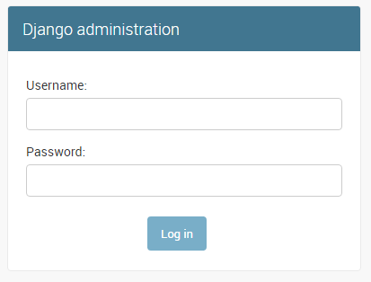
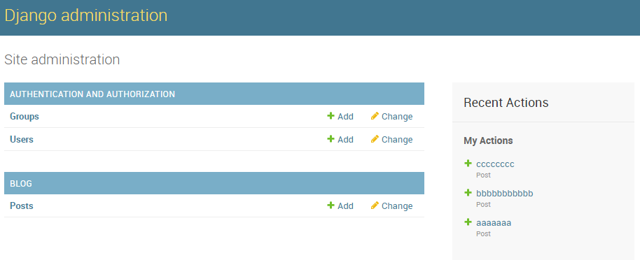
The Django admin
Built in Administration interface for our project

Slide 24
To sum up
Fast development: take a web application from concept to launch in a matter of hours
Fully loaded: Django includes dozens of extras you can use to handle common Web development tasks.
user authentication
content administration
site maps
RSS feeds
Security: helps developers avoid many common security mistakes
SQL injection
cross-site scripting
cross-site request forgery
Clickjacking
Scalable: ability to quickly and flexibly scale to meet the heaviest traffic demands

